Slide 1



Rajasthan Police Hackathon 1.0
Lost And Found System
TEAM NAME :- APEX
Team Members :- Sanskruti Ukey
Piyush Selotkar

Slide 2


AIM
"To develop a robust Lost and Found System connecting users and police for efficient management and recovery of lost items."

Slide 3

Introduction
Welcome to Rajasthan Police Hackathon 1.0 - Lost and Found System!
In a bustling world, losing valuable possessions is distressing. Our project strives to ease this distress by creating a seamless connection between individuals who have lost their belongings and the vigilant Rajasthan Police.
Our goal is to build a robust Lost and Found System that not only simplifies the process of reporting lost items but also empowers the police to efficiently match and recover these items. Let's embark on a journey to bridge the gap between lost property owners and the police, ensuring a faster and more effective recovery process.

Slide 4


Proposed Solution
USER SIDE
POLICE SIDE
Admin login for police.
Automated matching and notification
system.
Secure login and registration.
User-friendly Lost Product Application form.

Slide 5




TECHNOLOGY
REACT JS
NODE JS
MONGO DB
JSON WEB TOKEN

Slide 6


NOVELTY & UTILITY
NOVELTY
UTILITY
AI-driven matching for efficient lost item
recovery.
Provides a seamless platform for
users and police to collaborate
effectively.

Slide 7
OUTCOMES
Improved Community Safety:
Efficient Lost Item Recovery:
01
02
Strengthened collaboration between citizens and law enforcement results in a safer community.
Implementation of an AI-driven matching system accelerates the identification and retrieval of lost items.
Enhanced User Experience:
Improved Police Productivity:
03
04
Users experience a more user-friendly and accessible platform for reporting lost items.
Automated matching reduces the workload on police administrators, allowing them to focus on critical tasks.

Slide 8
FUTURE SCOPES
Automated Database Checks:
Real-time Notifications:
01
02
The system will regularly and autonomously cross-reference the lost items reported by users with the found items in the police database.
Once a match is found between a user's lost item and a found item in the database, an instant notification will be sent to the respective user.
Mobile Application Development:
PRIVACY SECURITY
03
04
Consider developing a dedicated mobile application for both users and law enforcement.
In the future, we plan to enhance the registration process by incorporating a feature that allows users to securely upload masked Aadhar images, providing an additional layer of privacy and security.

Slide 9
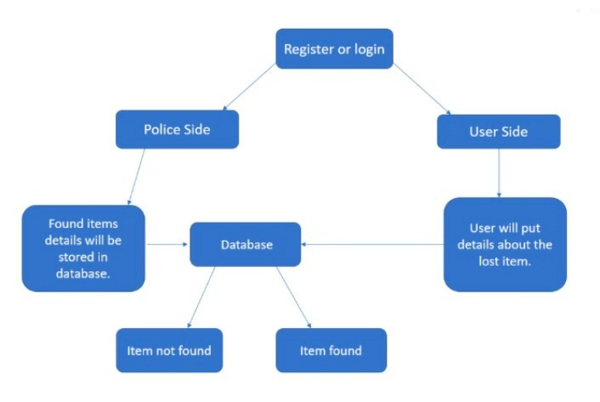
FLOWCHART
01
02
03
04

Slide 10


Slide 11


